Slide 1

Otium

Slide 2
1. Login API
http://remotehost/api/VI/loginapi/AccID
Multiple bank accounts in a single UI
Banks at your finger tips
Money transfer
2. Current Balance API
Open APIs from respective databases enhances the user experience on a basic level.
4
http://remotehost/api/VI/balenquiry/accdetails
1.Simple and secure banking
2.Transfer of beneficiary’s account data using respective API
Mini statements on the go
Combined statement of all your banks
3. Current loan details in just a tap
3. Statement details API
3
Simple and Customized UI for your every bank accounts
All bank balances in one window
2
http://remotehost/api/VI/statedetails/accdetails
1
4. Loan Details API
http://remotehost/api/VI/loan/accdetails
5. Money Transfer API
http://remotehost/api/VI/transfer/accdetails

Slide 3
Log in/Sing up to
Otium
and add bank accounts

Slide 4
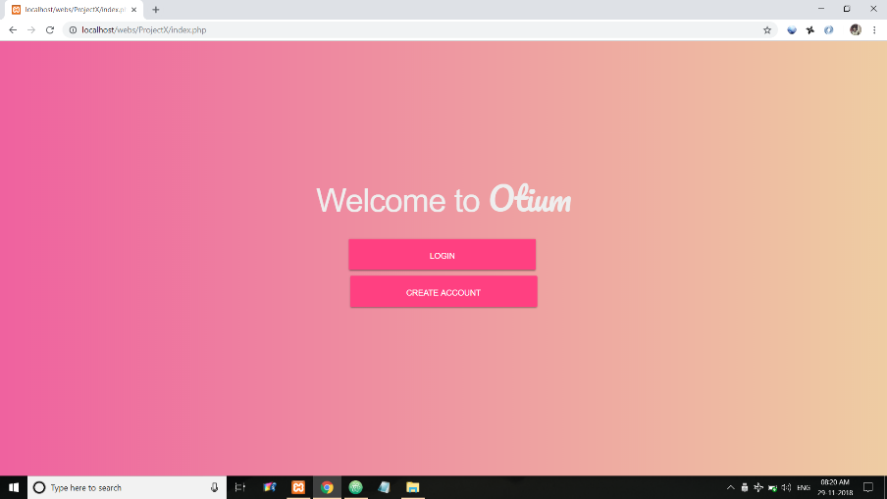
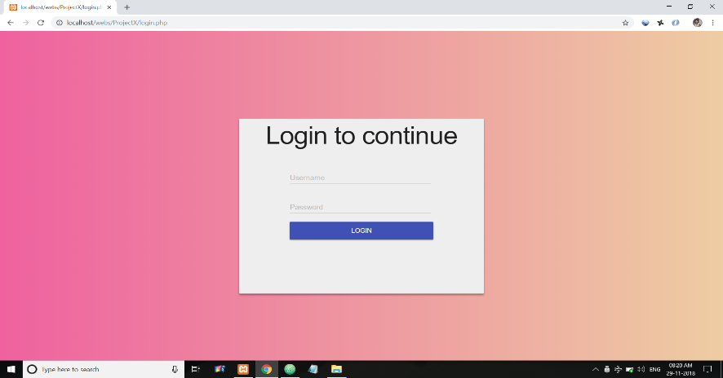
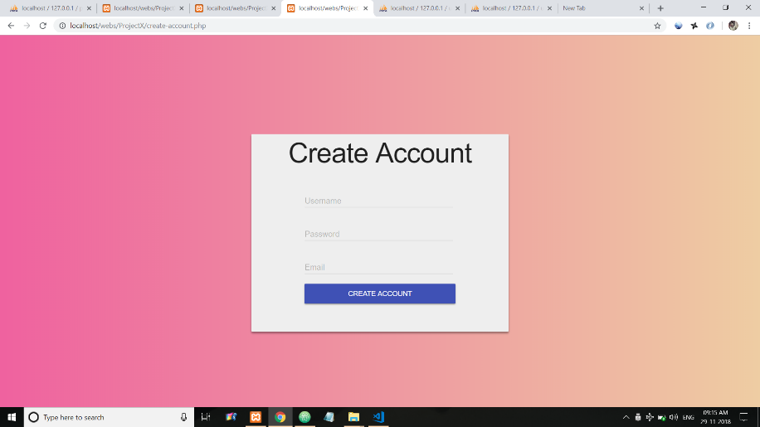
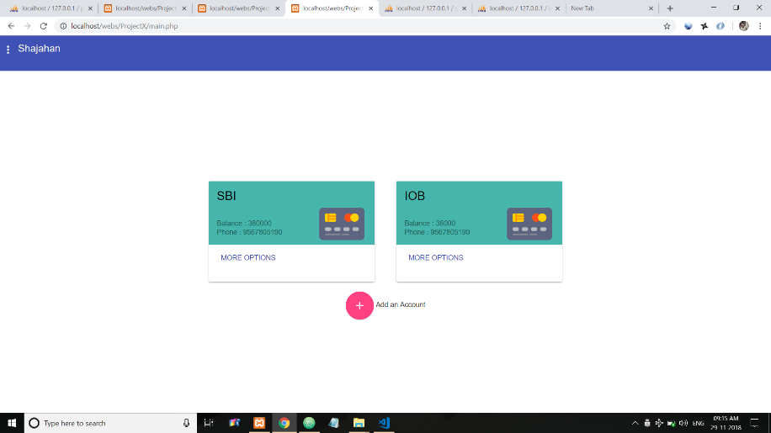
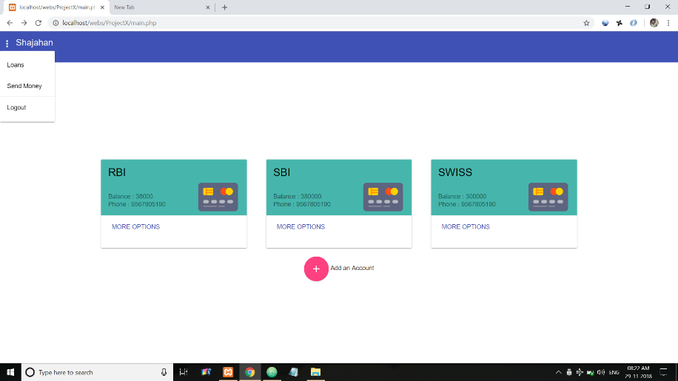
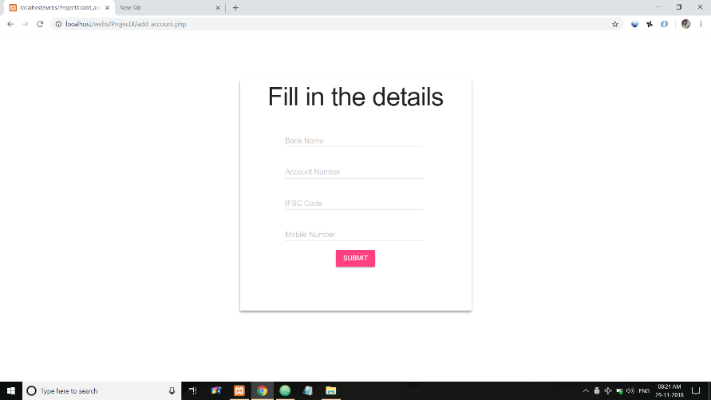
LogOut

Slide 5
All details are provided in a single tap with Otium

Slide 6
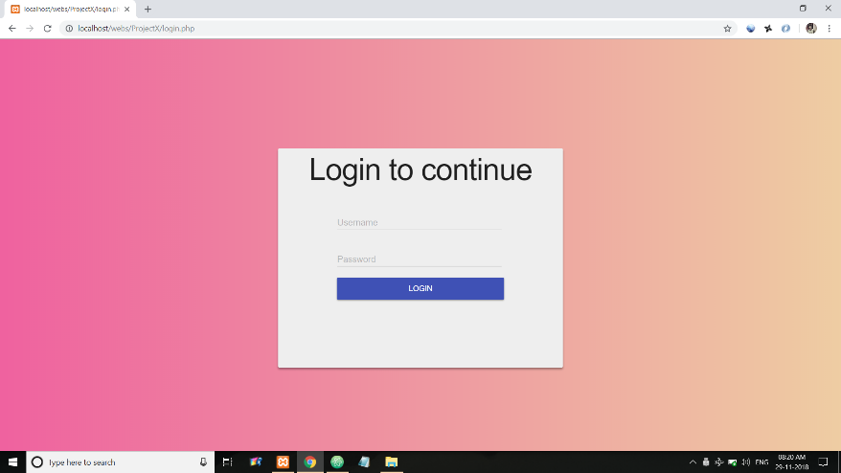
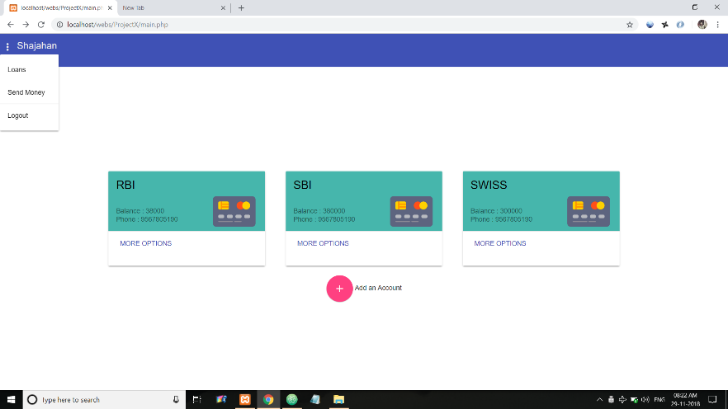
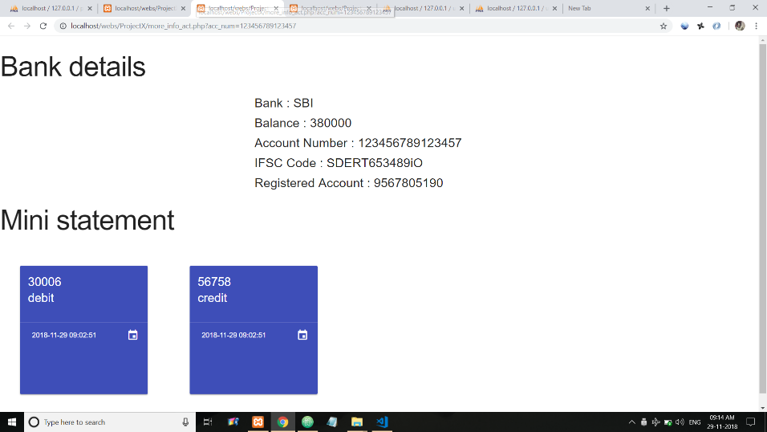

Slide 7
Otium

